Slide 1
Database Fundamentals
Chris Randall and Graeme Malcolm

Slide 2

Chris Randall
Senior Content Developer at Microsoft
Microsoft Certified Solutions Expert for the SQL Server Data Platform and Business Intelligence
Focused on creating content about the Microsoft data platform for:
Microsoft data platform
SQL Server
@cfrandall

Slide 3

Graeme Malcolm
Senior Content Developer at Microsoft
Worked with SQL Server since version 4.2
Focused on creating content about the Microsoft data platform for:
Database professionals
Developers
Data scientists
@graeme_malcolm

Slide 4
Agenda
1
Introduction to Databases
4
Optimizing Database Performance
2
Getting Started with Tables
5
Working with Non-Relational Data
3
Working with Data in Tables
6
Basic Database Administration

Slide 5
Introduction to Databases
Chris Randall and Graeme Malcolm

Slide 6
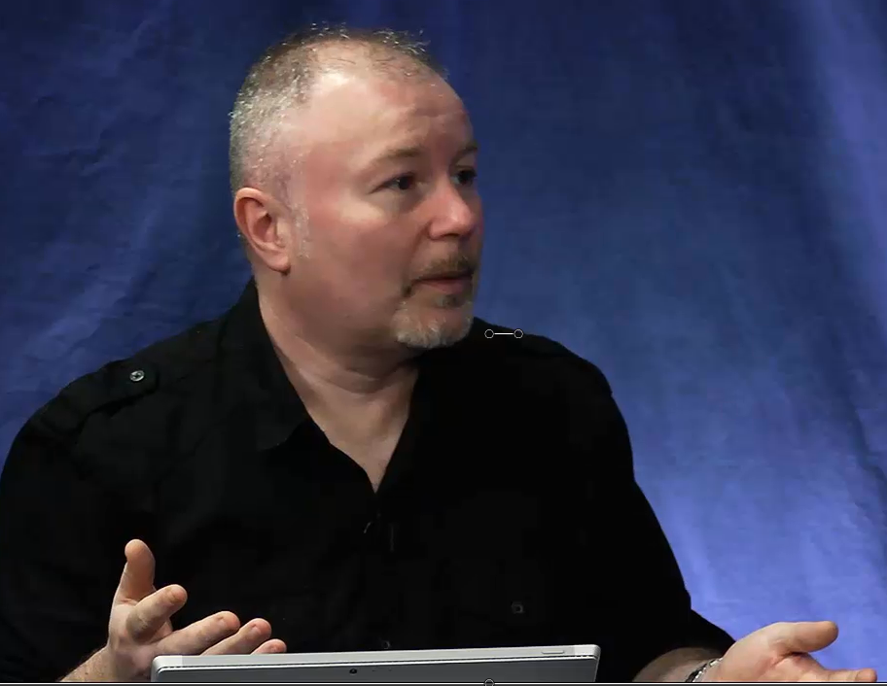
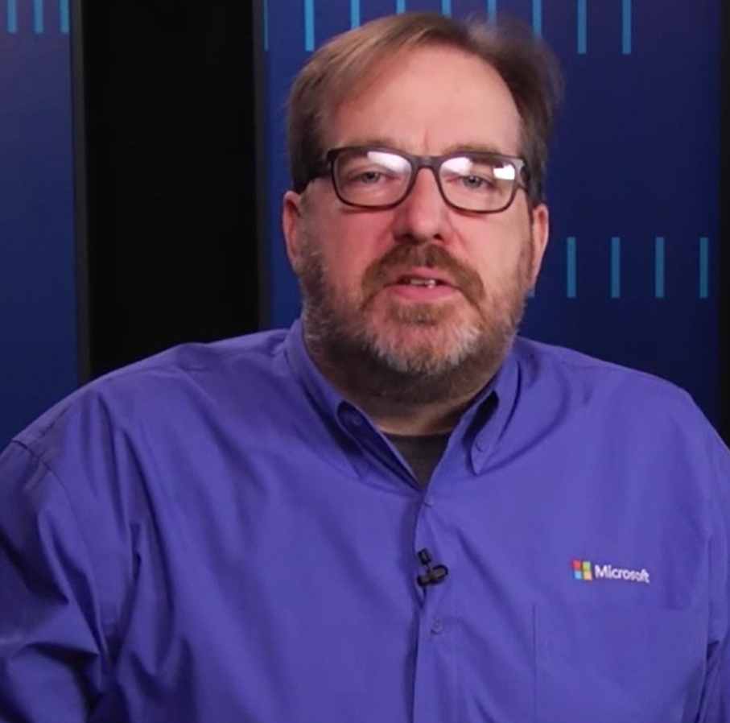
Let’s riff on data and databases for a few minutes Chris?
OK Graeme, there’s nothing I’d like better…

Slide 7
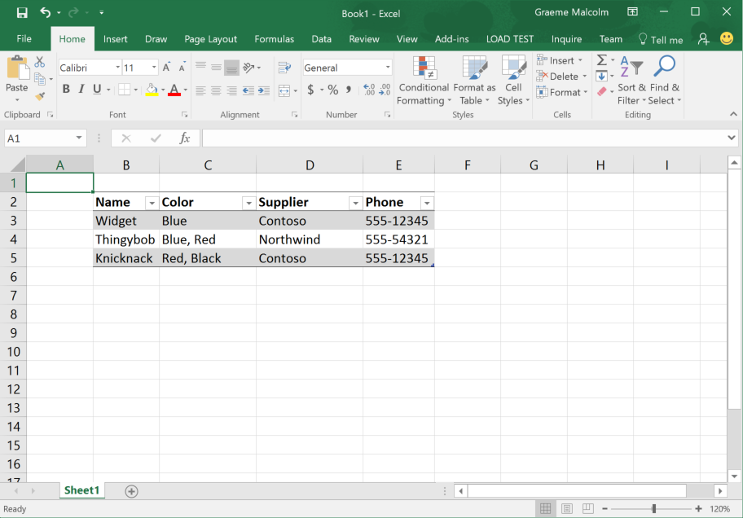
Notes:
Here’s an example of some data in a format you might be familiar with – but is it a database?
Well, kind of – at the very least, it’s a table of data – and that’s a format we’re used to dealing with.

Slide 8
Product |  |  |  |  | Color |  |  | Supplier
ProductID | Name | Phone | Supplier |  | ColorID | Color |  | SupplierID | Supplier
1 | Widget | 555-12345 | 1 |  | 1 | Blue |  | 1 | Contoso
2 | Thingybob | 555-54321 | 2 |  | 2 | Red |  | 2 | Northwind
3 | Knicknack | 555-12345 | 1 |  | 3 | Black
Product |  |  |  |  | Color |  |  | Supplier
ProductID | Name | Phone | Supplier |  | ColorID | Color |  | SupplierID | Supplier
1 | Widget | 555-12345 | 1 |  | 1 | Blue |  | 1 | Contoso
2 | Thingybob | 555-54321 | 2 |  | 2 | Red |  | 2 | Northwind
3 | Knicknack | 555-12345 | 1 |  | 3 | Black
 |  |  |  | ProductColor
 |  |  |  | Product |  | Color
 |  |  |  | 1 |  | 1
 |  |  |  | 2 |  | 1
 |  |  |  | 2 |  | 2
 |  |  |  | 3 |  | 2
 |  |  |  | 3 |  | 3
Product |  |  |  | Color |  |  | Supplier
ProductID | Name | Supplier |  | ColorID | Color |  | SupplierID | Supplier | Phone
1 | Widget | 1 |  | 1 | Blue |  | 1 | Contoso | 555-12345
2 | Thingybob | 2 |  | 2 | Red |  | 2 | Northwind | 555-54321
3 | Knicknack | 1 |  | 3 | Black
 |  |  | ProductColor
 |  |  | Product |  | Color
 |  |  | 1 |  | 1
 |  |  | 2 |  | 1
 |  |  | 2 |  | 2
 |  |  | 3 |  | 2
 |  |  | 3 |  | 3
Product |  |  |  |  |  | Supplier
ProductID | Name | Color | Phone | Supplier |  | SupplierID | Supplier
1 | Widget | Blue | 555-12345 | 1 |  | 1 | Contoso
2 | Thingybob | Blue | 555-54321 | 2 |  | 2 | Northwind
3 | Knicknack | Red | 555-12345 | 1
4 | Thingybob | Red | 555-54321 | 2
5 | Knicknack | Black | 555-12345 | 1
Product
Name | Color | Supplier | Phone
Widget | Blue | Contoso | 555-12345
Thingybob | Blue, Red | Northwind | 555-54321
Knicknack | Red, Black | Contoso | 555-12345
Product
Name | Color | Supplier | Phone
Widget | Blue | Contoso | 555-12345
Thingybob | Blue | Northwind | 555-54321
Knicknack | Red | Contoso | 555-12345
Thingybob | Red | Northwind | 555-54321
Knicknack | Black | Contoso | 555-12345
Notes:
This slide is ANIMATED
First, here’s the table of product data we saw in Excel.
CLICK
However, notice that the color values are irregular – some products have more than one color, so our table isn’t always storing just one piece of information in a column. We need to fix the way the data is stored through a process called normalization.
CLICK
Now we’ve ensured that each column contains only one value, and there are no repeated columns (i.e. there aren’t multiple Color columns). This is known as First Normal Form or 1NF.
CLICK
However, we have some duplicated values in the table, for example Supplier – which is inefficient in terms of storing the data, and can lead to problems later on if we need to update the same value in multiple places.
CLICK
So we split out the duplicated suppliers into a separate table (each table representing an entity in our database), and use primary keys to identify each instance of an entity. This is known as Second Normal Form or 2NF.
CLICK
We also have duplicate colors and product names
CLICK
So we take the same approach and create a second table for the Colors, and eliminate the duplicate products.
CLICK
However, removing the duplicate product rows means there’s no way to relate each product to a specific color.
CLICK
So we add another table - Note that the ProductColor table is not actually a real entity, but a way to link instances of one entity (Product) to instances of another (Color). Note also that it’s key is actually a composite of the two columns
CLICK
However, something’s still not quite right. Look at the product table. The Phone field isn’t really an attribute of a Product.
CLICK
So we progress to Third Normal Form (or 3NF), in which we ensure that each field depends on the primary key of the table in which it is defined. In this case, the Phone field is actually dependent on the Supplier.

Slide 9
So how are these tables actually stored Chris?
Well Graeme, I’m glad you asked…

Slide 10
Product |  |  |  | Color |  |  | Supplier
ProductID | Name | Supplier |  | ColorID | Color |  | SupplierID | Supplier | Phone
1 | Widget | 1 |  | 1 | Blue |  | 1 | Contoso | 555-12345
2 | Thingybob | 2 |  | 2 | Red |  | 2 | Northwind | 555-54321
3 | Knicknack | 1 |  | 3 | Black
 |  |  | ProductColor
 |  |  | Product |  | Color
 |  |  | 1 |  | 1
 |  |  | 2 |  | 1
 |  |  | 2 |  | 2
 |  |  | 3 |  | 2
 |  |  | 3 |  | 3
Notes:
This slide is ANIMATED
Well, here’s our normalized schema of tables.
CLICK
The metadata and data for these is physically stored on disk.
CLICK
The storage and access of the data is managed by a database server (running software known as a relational database management system or RDBMS – such as SQL Server).
CLICK
Client applications that store and use data in the database access it over a network connection.
CLICK
The database server can be on a corporate network, or increasingly hosted in a cloud service such as Microsoft Azure.
CLICK
Either way, access to the database server is usually restricted to specific client computers using a firewall…
CLICK
And only authorized users and applications are allowed to access the data in the database.

Slide 11
Wow Chris! That’s really exciting, can we see a demo of this?
Sure thing Graeme, …

Slide 12
Getting Started with Databases
Creating a database and performing initial configuration

Slide 13
So, what have we learned in this module Chris?
Well Graeme, …

Slide 14
Databases are used to store data in tables
Usually, we normalize these tables to create a relational schema
The tables are stored on disk, and managed in a database server
Client applications access the database across a network
Increasingly, the database server is hosted in the cloud
Access to data in a database is restricted using firewalls and authentication

Slide 15
That was really fascinating Chris?
I know Graeme, we rock…

